Slide 1
Usability End-Term Exam ‘Transportation’
Joydeep (MT2013062)

Slide 2
Issues in Transportation
In a city, if one person wants to travel from one location to another there are very limited resource that helps him/her to reach to that position. Eg. Google Maps
Google apps tells us about the routes, bus numbers, and traffic situation. But it does not do any real time tracking of the busses.
Our agenda is built an ecosystem that will help the user to board Right bus to reach to his/her destination (in terms of his convenience ).

Slide 3
Hardware Support
Each bus will contain three electronic devices. Bus tracker : It tells the monitoring server about the bus location. Mobile device tracker : It tells about the number of mobile devices(cell phone) in the bus. Traffic tracker: It tells about which route gets a green/red light for how much time.
A central server which manages all the data coming from all the three devices.
The App server that suggests a person to board best suitable bus.

Slide 4
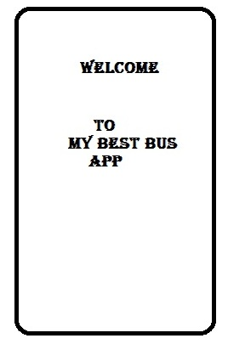
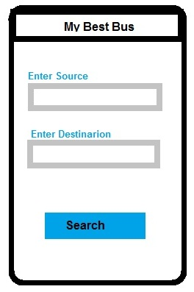
Software support (The app)

Slide 5
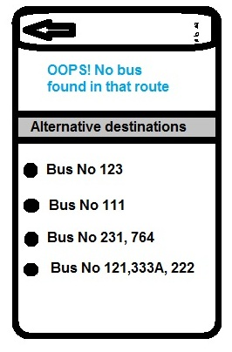
Software support (The APP)…
If no busses are found from source to destination, it will suggest all destinations with in a range to the user input destination.
User can select one of the suggested bus(es).

Slide 6
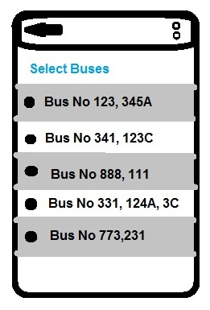
Software support (The APP)…
In case of buses available from source to destination it will list the bus numbers.
The bus numbers are arranged based on choices made earlier by the user. For eg if the user has chosen an A/C bus all A/C buses will be displayed above the non A/c buses.

Slide 7
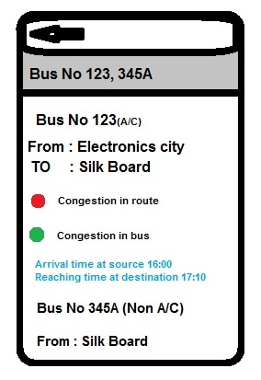
Software support (The APP)…
When user selects a bus, the app displays following information
The bus source and destination in the user defined route(user source and user destination)
Congestion in the route(Red = Highly congested , green = no congestion)
Congestion in the bus: this feature tells whether there is a chance to get a seat in the bus or not.
Arrival time at source and reaching time at destination based on the traffic which will be calculated at the App server.
There may be a combination of buses to reach the destination. The app will show all the above information of all the busses.
At the end the app will show the best bus as per heuristics

Slide 8
Over All Architecture
Bus location tracker
Mobile location tracker
Road Traffic
tracker
Central server
Mobile Device
App server

Slide 9
The user model
Basic requirements a smart phone Internet connectivity
Age group : 15 to 70
Sex : Male, female and others.
Language : English or others (any listed language in constitution).
Education : Those who can read English or others (as mentioned above)
Technical knowledge : Not required (very basic).

Slide 10
The User Environment
Environment conditions : As long as the mobile device works.
Using conditions : Naked fingers or thin gloves.
Hardware : mobile/ Pda’s
OS : Android/ IOS/Windows

Slide 11
Task 1
User Scenario ID: 001
User Scenario Name: Downloading the App
Created By: Joydeep
Last Updated By: Joydeep
Date Created: 12/13/2014
Date Last Updated: 12/13/2014

Slide 12
Task 1…
Description: Downloading the App in the Device
Trigger: The User wants to download the app from the app store and use it.
Preconditions: The device should have internet connectivity, appropriate space in RAM and ROM
Post conditions: the app is installed in the device and ready to serve requests.
Normal Flow: Open App Store -> Search for App -> hit the download button.
Alternative Flows: Go to the www.thebusapp.com ->enter your mobile OS -> hit download and install button.
Exceptions: The user should be from the region where the app has license to operate
Priority: 3
Frequency of Use: Very Rare (once every device )

Slide 13
Task 1…
Business Rules: The App should be allowed to gain all purchase information, internet connectivity and gps.
Special Requirements: The devise should have OS versions released in recent two years.
Assumptions:
Error conditions: No internet connectivity No enough Space in ROM App server not responding.

Slide 14
Task 2
User Scenario ID: 002
User Scenario Name: Searching best Bus
Created By: Joydeep
Last Updated By: Joydeep
Date Created: 12/13/2014
Date Last Updated: 12/13/2014

Slide 15
Task 2 …
Description: Searching buses based on user input source and destination
Trigger: The User wants to search for buses from a source to destination.
Preconditions: The source and destination should be from the permissible list based on the location of the device through GPS.
Post conditions: The user either gets the list of buses, an error saying unrecognized source/destination or list of destination to specified destination.
Normal Flow: Launch the App -> Enter Source (choose from list as user enters) -> Destination (choose from list as user enters)-> Hit Search button
Alternative Flows: No alternative flow.
Exceptions: The user should be from the region where the app has license to operate
Priority: 2
Frequency of Use: Very High (15 per user per day)

Slide 16
Task 2…
Business Rules: The App should be allowed to gain all purchase information, internet connectivity and gps. The app should have information about the source and destination.
Special Requirements: The devise should have OS versions released in recent two years.
Assumptions:
Error conditions: No internet connectivity. No source found. No destination found. Other Apps Causing problems in functionality of the app.

Slide 17
Task 3…
User Scenario ID: 003
User Scenario Name: Selecting a bus from suggested list
Created By: Joydeep
Last Updated By: Joydeep
Date Created: 12/13/2014
Date Last Updated: 12/13/2014

Slide 18
Task 3…
Description: Selecting buses from the list based on user input source and destination.
Trigger: The User wants to gain information about a bus(es) from suggested list.
Preconditions: The user have the app in their device and want to gain information about the bus(es) from a permissible source and permissible destination .
Post conditions: The user either gets information list of that bus(es) or an error.
Normal Flow: Launch the App -> Enter Source (choose from list as user enters) -> Destination (choose from list as user enters)-> Hit Search button-> tap on the bus number
Alternative Flows: No alternative flow.
Exceptions: The user should tap in the button permissible region to get information list.
Priority: 1
Frequency of Use: Very High (35 per user per day)

Slide 19
Task 3 …
Business Rules: The App should be allowed to gain all purchase information, internet connectivity and gps. The app should have information about the source and destination. The app connects to app server for information list of the selected bus(es) no.
Special Requirements: The devise should have OS versions released in recent two years.
Assumptions:
Error conditions: No internet connectivity. Other Apps Causing problems in functionality of the app. Server inactive Server taking too long to respond.

Slide 20
Thank you

